Slide 1
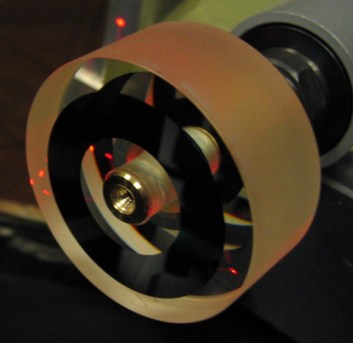
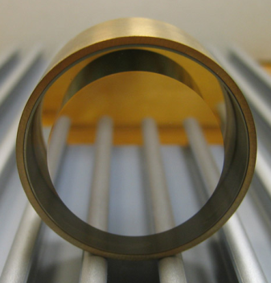
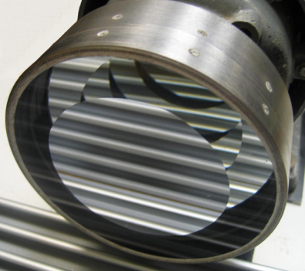
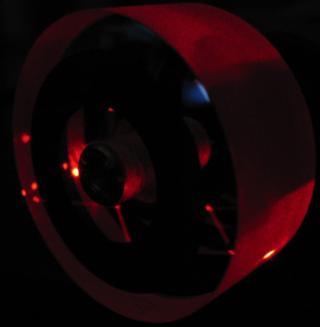
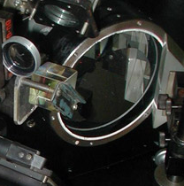
Bauman Moscow State Technical University
Scientific-Educational Complex «Fundamental Sciences»
New Effects of Moving Media Optics
Research supervisor: Vladimir O. Gladyshev, D.Sc. (Phys.-Math.)
www.space-lab.ru

Slide 2
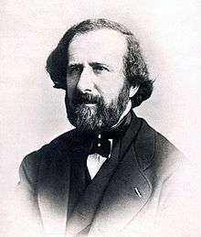
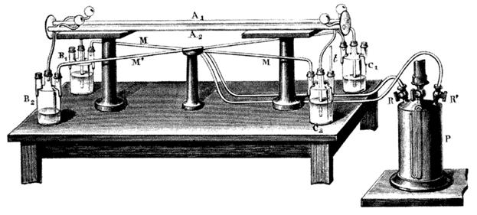
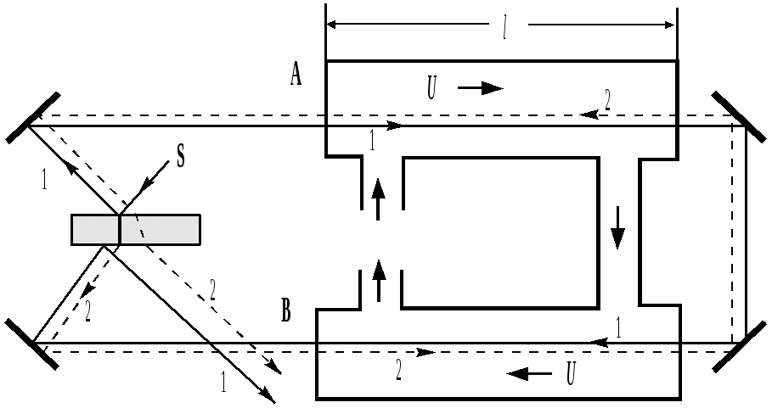

Historical background
In 1851 Hippolyte Fizeau conducted an experiment aimed at measuring the speed of light in water moving at 7 m/s.
With this experiment, the light drag coefficient could be estimated.
In Fizeau’s times there were no lasers, photodetectors and computers, which prevented the effect from being used for applied purposes.

Slide 3
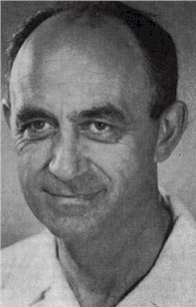
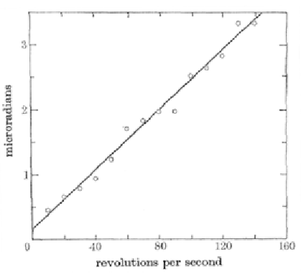
In 1923, Enrico Fermi predicted the effect of polarization angle rotation of an electromagnetic wave normally incident upon a rotating dielectric (Fermi E. Rend. Lincei., 1923, V.32(I), 115).
Historical background
For a cylindrical lens, polarization angle rotation is
Δφ=10⁻⁶ rad
(Ω = 1000 rpm, L=10 mm)
In 1976 R. Jones experimentally verified E. Fermi's formula for a 10-cm-long cylinder.
Rotation angle appr. Δφ=10-6 rad

Slide 4
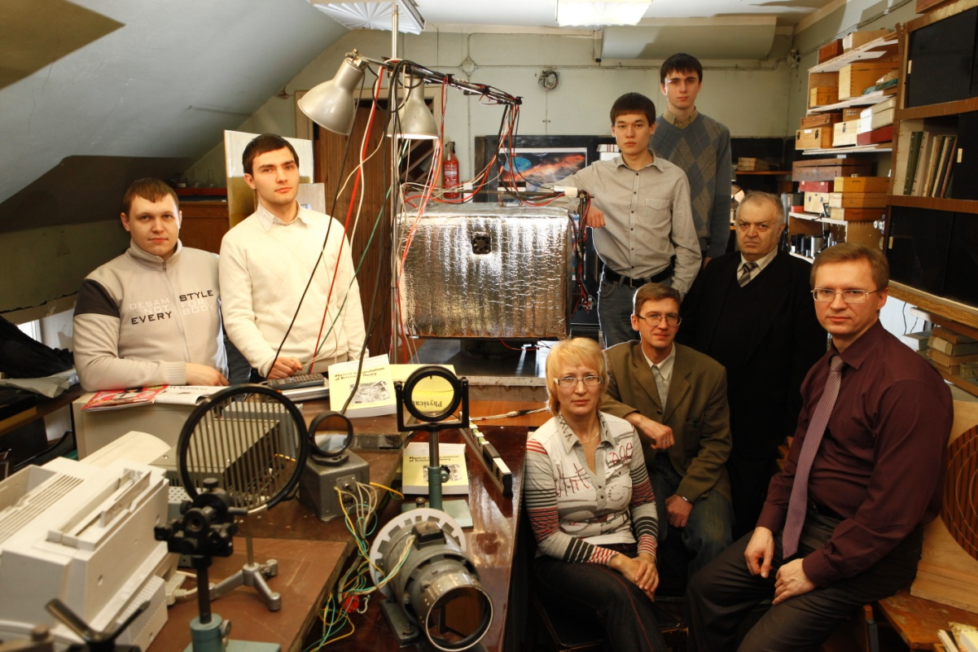
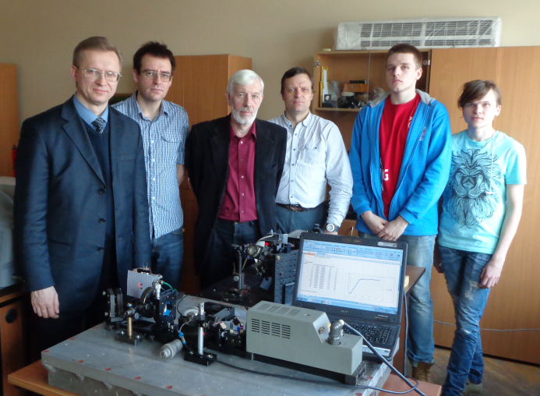
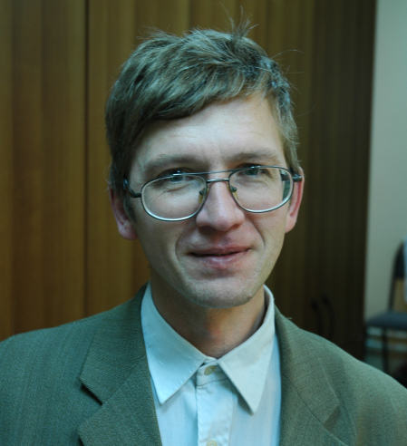
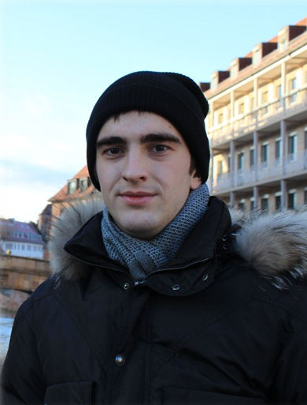

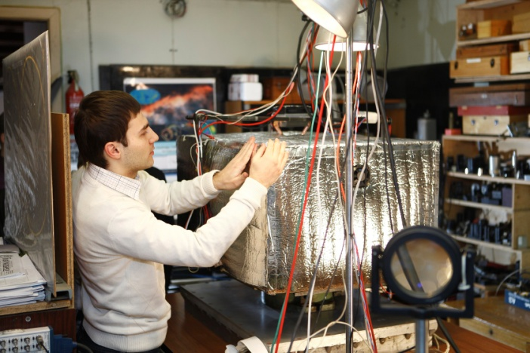
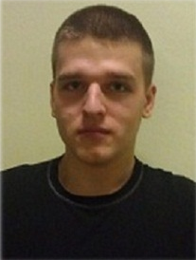
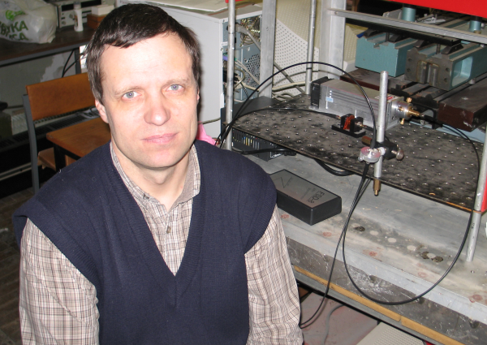
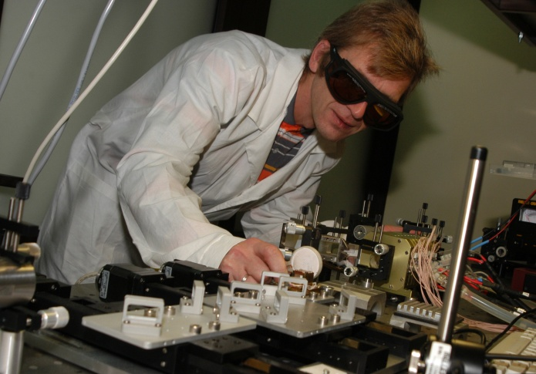
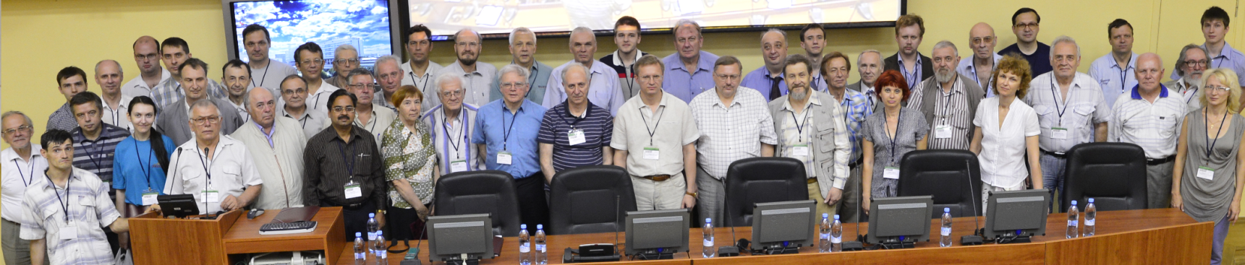
PIRT International Conference (London-Moscow)
Laboratory of moving media optics
Research done by the staff, students and PhD students of FS, IC and RL faculties

Slide 5
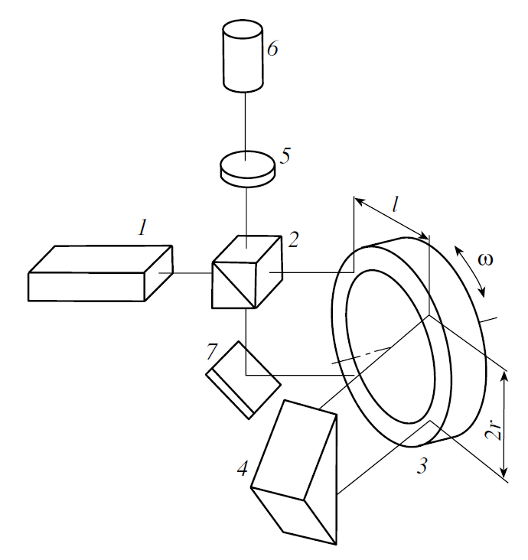
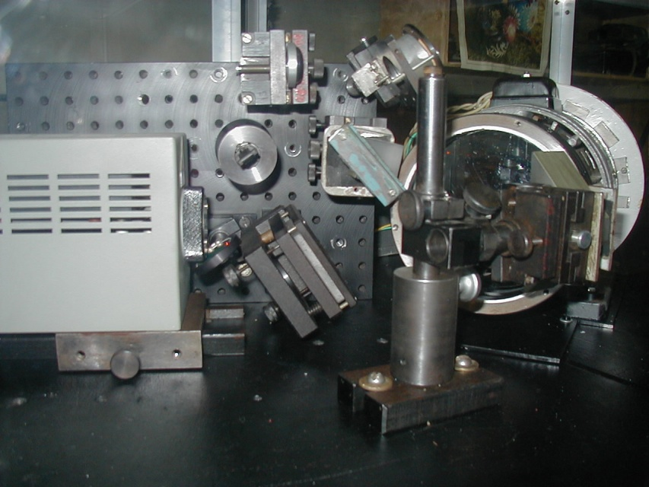
The Fizeau effect observed at 3.5 m/s velocity
Two-beam two-pass interferometer Two-mirror optical disc for reflected light
The spatial light dragging effect was observed for λ= 0.63229 μm by means of an optical disc with radius R₀= 0.06, rotating at ω = 25 Hz.

Slide 6
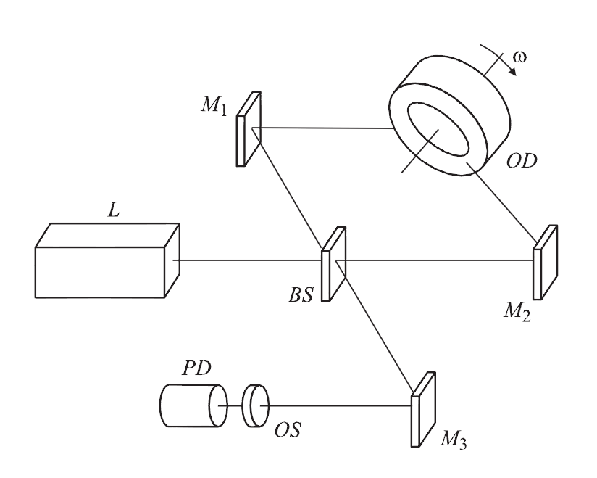
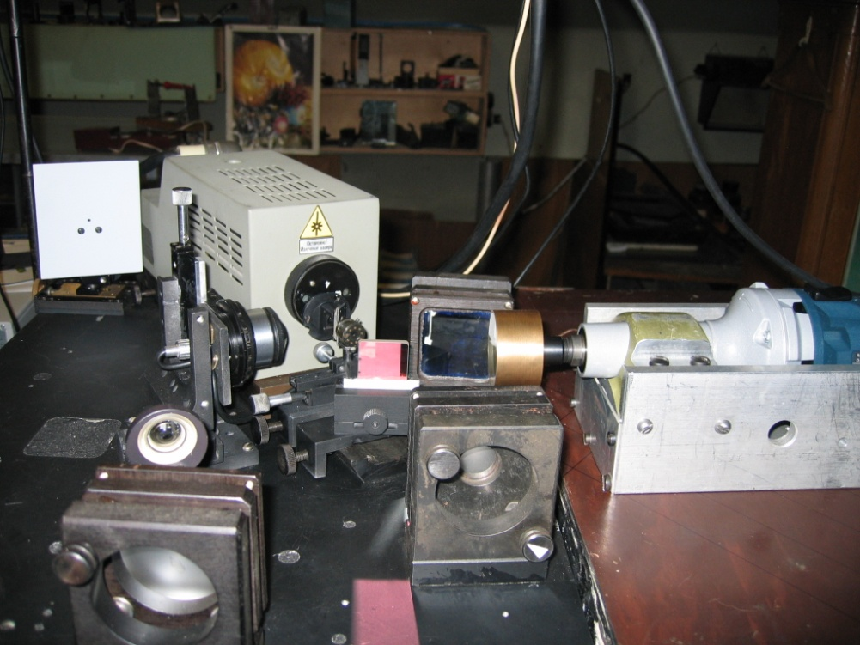
The Fizeau effect investigated in the velocity range up to 36 m/s
Two-beam one-pass interferometer. Two-mirror optical disc for reflected light
The linear dependence of the interference fringe shift on the moving velocity of medium was measured, for incident angle ϑ₀ = 53.5° upon flat reflecting surface and rotation frequency 100 – 380 Hz.

Slide 7
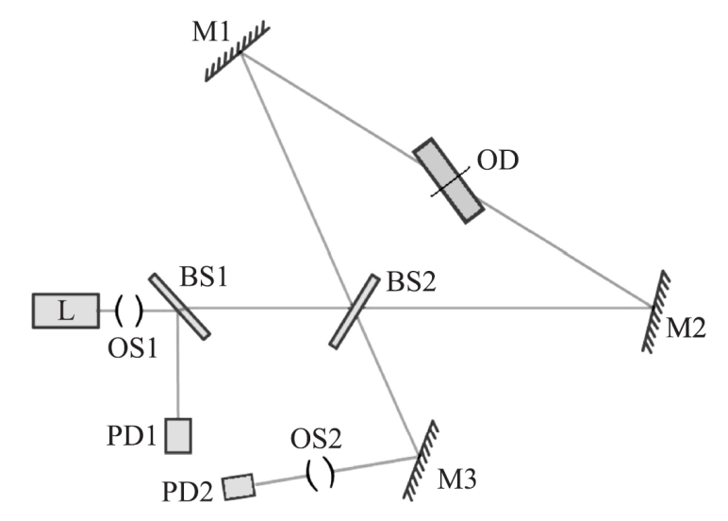
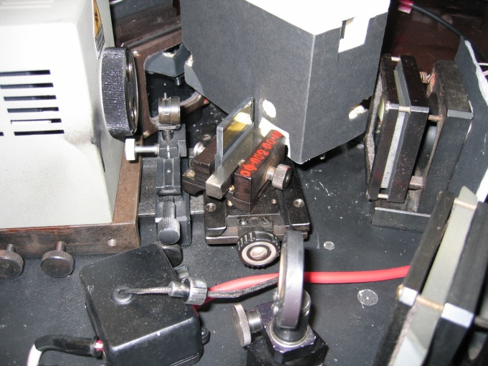
The Fizeau effect and the limitations of Snell’s law with a 10⁻⁵ error investigated
Two-beam one-pass interferometer Two mirror-optical disc for transmitted light
The spatial anisotropy of the electromagnetic radiation velocities was investigated in a rotating disc with flat mirror faces at 60° incident angle with an error δΔ =3x10⁻⁵ units.

Slide 8
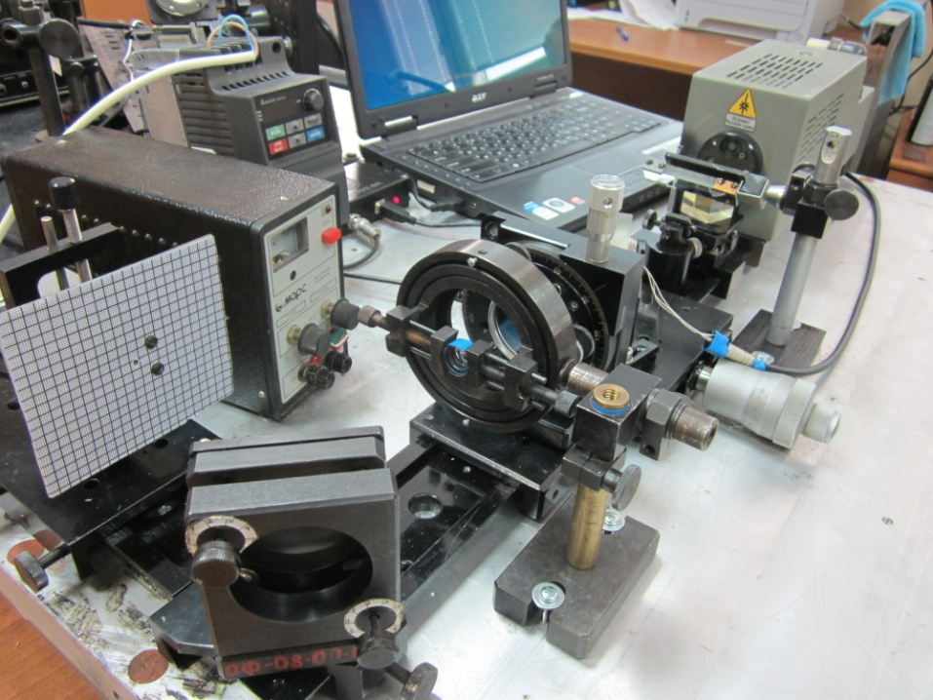
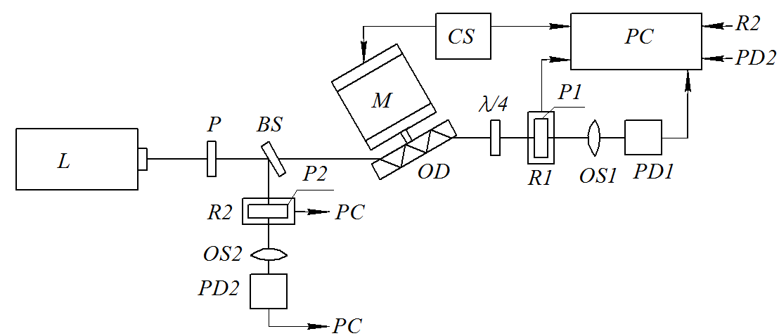
Polarization in a rotating glass disc investigated
The polarization plane rotation and polarization degree were determined as a function of disc rotational frequency up to 200 Hz in glass with a refractive index n=1.71250.

Slide 9
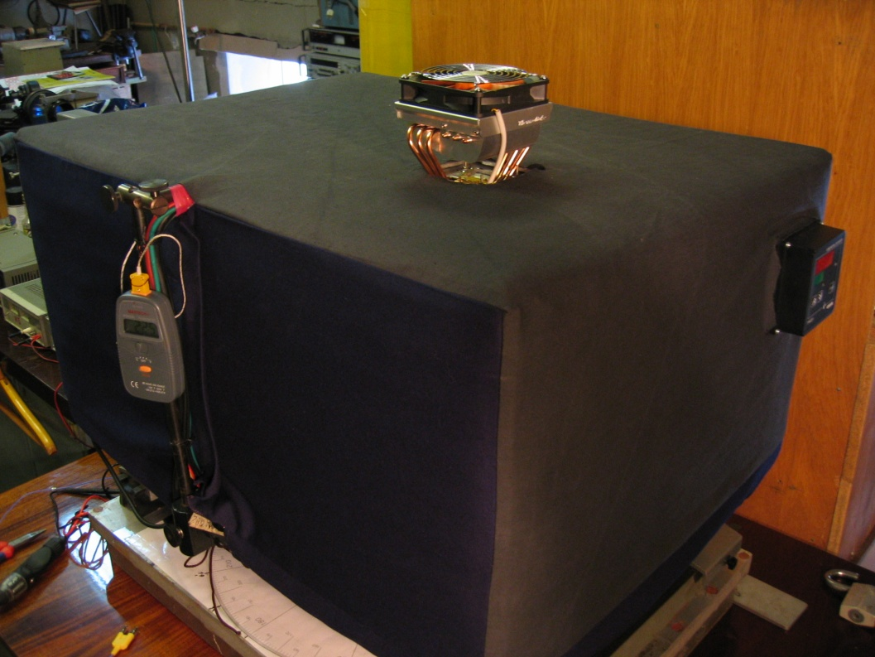
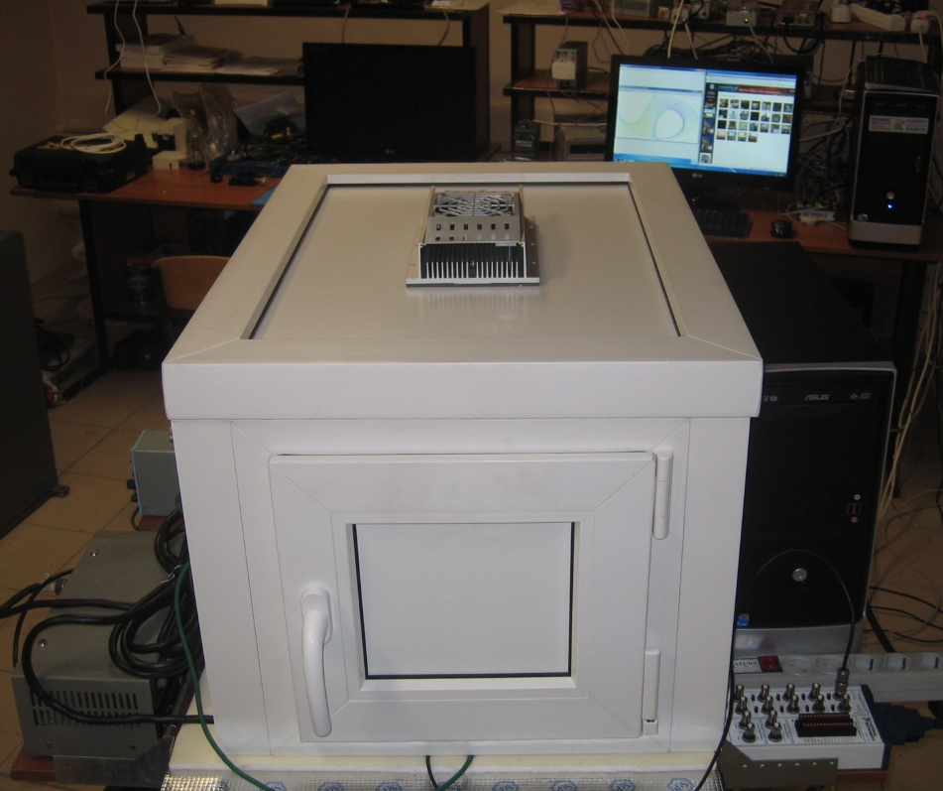
Space Anisotropy Detection Experiment (SADE)
in progress
Thermally stabilized automated interferometer with remote control and data processing, IBM Mainframe Center of Excellence, Bauman MSTU

Slide 10
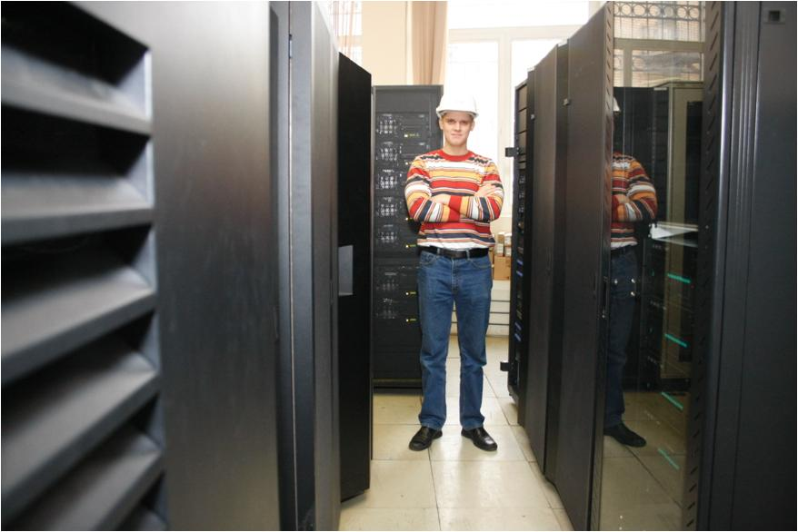
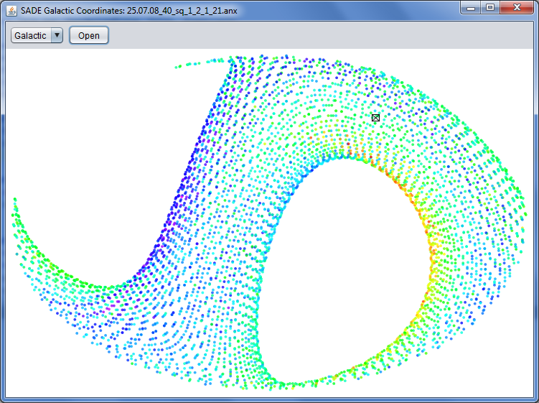
SADE experiment.
Foundation for creating navigation systems based on a new physical principle.
Experiment remote control and data processing at IBM Mainframe Center of Excellence, Bauman MSTU
Presentation of experimental data in galactic coordinates (determination of the movement velocity in space)

Slide 11
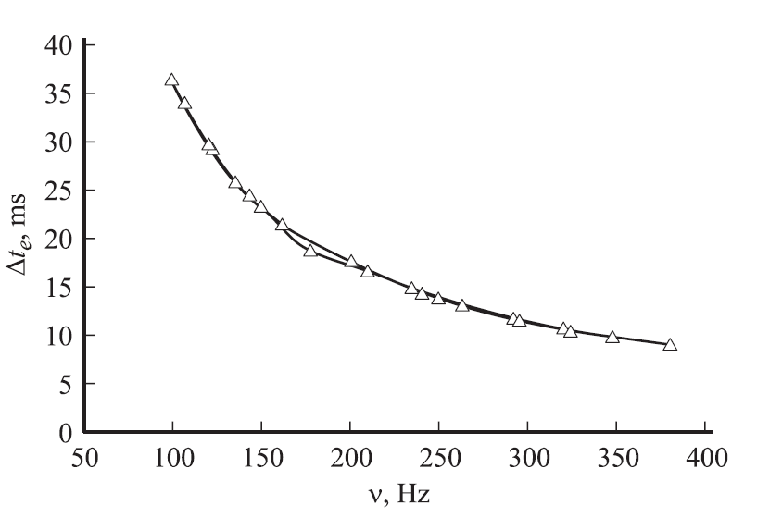
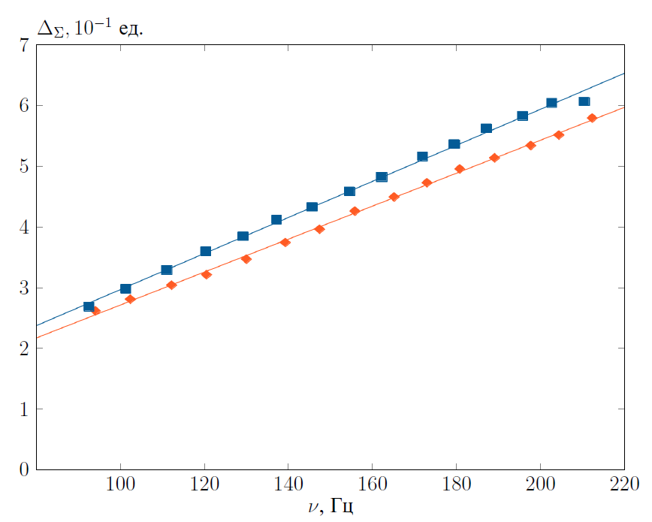
New effects
Fig.1. Dependence of the time of interference fringe passage over FD aperture on the optical disc rotational frequency
Fig.2. Dependence of interference fringe shift on the optical disc rotational frequency for two directions of rotation ( 95% agreement with calculation).

Slide 12
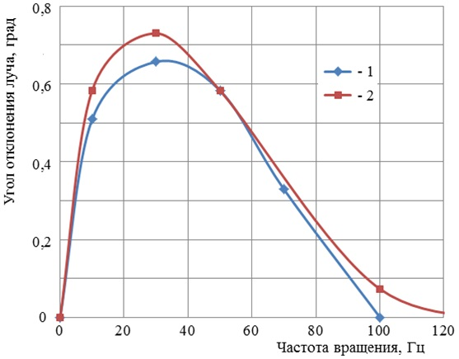
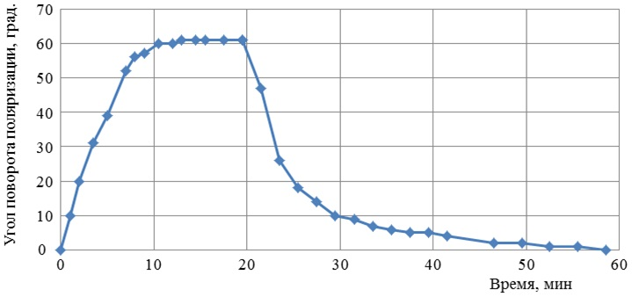
New effects
Fig.3. Dependence of rotation angle of polarization plane ∆φ on time t at f=80 Hz. At the moment of time t=20 min, the motor was switched off and the optical disc stopped. Relaxation time of glass properties is at t=1000 с.
Fig.4. Dependence of beam deflection angle on the optical disc rotational frequency. Initial polarization of laser radiation 1) horizontal; 2) vertical.

Slide 13
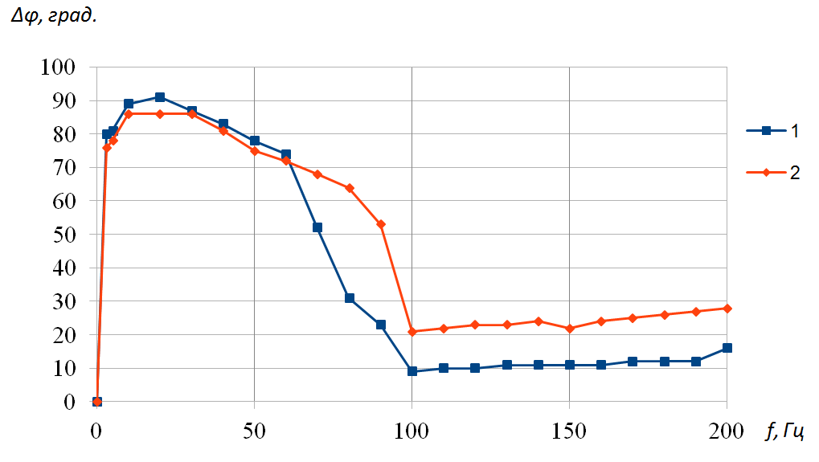
New effects
Fig.5. Non-linear dependence of angle of polarization plane rotation ∆φ on the optical disc rotational frequency f.
Initial polarization of laser radiation 1 - horizontal; 2 - vertical.
Fig.6. Non-linear dependence of voltage on the FD on time due to depolarization
(1 - signal amplitude at the initial position of the polarizer, 2 - signal amplitude after rotating the polarizer)

Slide 14
Results and conclusions
The effect of light beam deflection in a rotating optical disc was predicted.
The solution of Maxwell's equations in a moving medium in the presence of a tangential discontinuity in velocity was experimentally verified.
New properties of electromagnetic radiation in a rotating dielectric were investigated experimentally:
Limitations of Snell’s law at tangential discontinuity in velocity;
Rotation of polarization plane, depolarization, ellipticity;
Angular deflection of a laser beam in a rotating optical disc.
The movement of the atmosphere leads to a change in the phase velocity of the electromagnetic wave and an error in determining the aircraft coordinates.
The observed effects enable a simple ultra-small device to control the beam parameters.
The effects are not dependent on the changes in the medium.

Slide 15
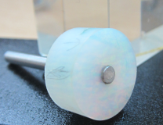
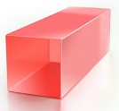
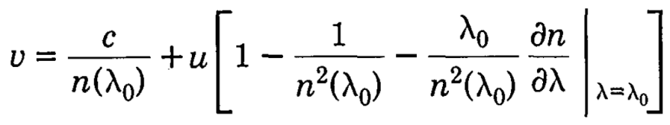
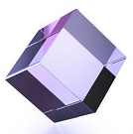
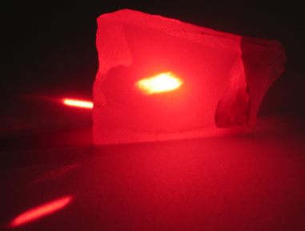
Further research
1. Investigating effects in various types of glass for various wavelengths.
2. Influence of the material dispersion:
3. Investigating the influence of the media purity on the magnitude of the effect.
4. Creating a multi-beam interferometer.
5. Investigating effects in moving photon crystals.
6. Investigating effects in optical crystals and active media.
7. Research in the field of low-frequency acousto-optics.
8. Searching for relevant engineering applications.

Slide 16
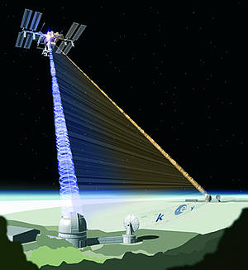
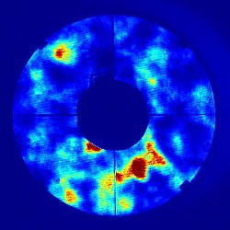
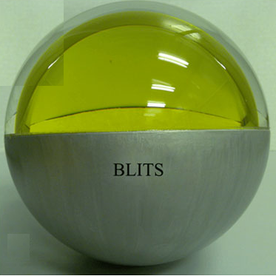
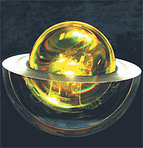
Potential applications
New methods for controlling laser radiation parameters.
Influence of effects on the coherent data transmission in the atmosphere.
Enhanced precision of satellite navigation systems.
New-generation passive laser mini-satellites based on a Luneburg lens.
A new method for the selection and control of ultra-high purity optical materials.
Enhanced accuracy of sighting and aiming systems in overload conditions.
Expanded functionality of high-precision laser gyroscopes.
Потребители: Минобороны России, Роскосмос.

Slide 17
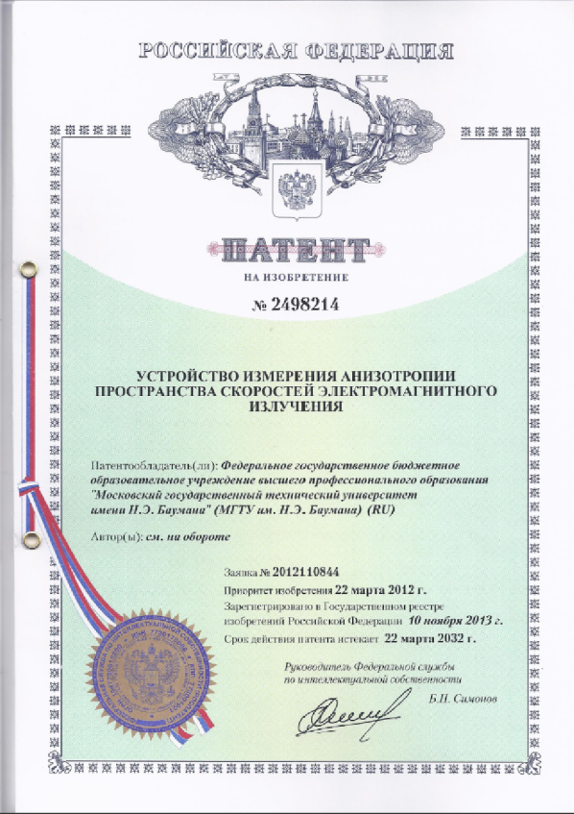
Key publications
(full list at www.space-lab.ru)
Experimental setup patent
Patent No. RU2498214. A device for measuring the space anisotropy of electromagnetic radiation velocities. Gladyshev V.O., Tiunov P.S., Leontiev A.D., Sharandin E.A. IPC G01C19/58 (2006.01). Publ. 11/10/2013. Bul. No. 31.
Polarization
[1]. Gladyshev V.O., Portnov D.I., Kauts V.L., Sharandin E.A. Experimental investigation of laser radiation ipolarization in rotating optical glass // Optics and Spectroscopy. -Т.115, no. 3, pp. 398-405 (2013). [In Russian]
Designing experimental setup
[2]. Gladyshev V.O., Tiunov P.S., Leontiev A.D., Gladysheva T.M., Sharandin E.A. Investigation of the space anisotropy of electromagnetic radiation velocities in a moving medium // Technical Physics. –Vol. 82, No. 11, pp.54-63 (2012). [In Russian]
[3]. Gladyshev V.O., Gladysheva T.M., Dashko M., Trofimov N., Sharandin E.A. The first results of measuring the dependence of the spatial drag of light in a rotating medium on the rate of rotation // Technical Physics Letters. -Vol. 33, No. 21, pp. 17-24 (2007). [In Russian]
[4]. Gladyshev V.O., Gladysheva T.M., Zubarev V.E. Registration of the effect of light drag in a disk optical interferometer // Technical Physics Letters. - Vol. 28, No. 3, pp.88-94 (2002). [In Russian]
Theory
[5]. Gladyshev V.O. Propagation trajectory deflection of a monochromatic electromagnetic plane wave in a medium with rotation // JETP Letters. - Vol. 58, Iss..8. -С.593-597 (1993). [In Russian]
[6]. Gladyshev V.O. Propagation of a monochromatic electromagnetic plane wave in a complex motion medium // Technical physics. - Vol. 69, Iss.5. – pp. 97-100 (1999). [In Russian]
[7]. Gladyshev V., Gladysheva T., Zubarev V. Propagation of electromagnetic waves in complex motion media // Journal of Engineering Mathematics. - Vol. 55. No.1-4, pp.239-254 (2006).

Slide 18
Research in this field conducted by:
Naval Research Laboratory USA;
US Air Force Office of Scientific Research;
DARPA - Defense Advanced Research Projects Agency
NATO, US National Bureau of Standard, National Science Foundation, Office of Naval Research;
US National Aeronautics and Space, Research Laboratory of Electronics;
US National Science Foundation
CNRS (CERN);
UK Engineering and Physical Sciences Research Council;
Royal Society of New Zealan;
UK Engineering and Physical Sciences Research Council.

